Slide 1
Hi presenter! Read me before using!
This webinar resource is almost ready for you to use! Be sure to:
Look through and add custom information
Slide #2- Title slide (date)
Slide 3- Presenter information
Slide 5- Housekeeping items
Slide 18- Resources (optional)
Slide 20- Thank you slide
There are presenter notes to help guide you- feel free to edit these
This resource can be customized. Here are some examples of how you can personalize this slide deck to suit the needs of your educators and staff:
Replace our images with screen shots from your environment
Read through slides and ensure terms and jargon will resonate with your board policies/ tool names in your Brightspace environment (i.e. Assignments vs Dropbox, Announcements vs News)
Add additional information to slides specific to your district, including how this helps meet district goals, improvements plans, strategic plans etc
Include your district logo on slides or change the colors used to match your district branding

Slide 2
An Introduction to Assessment and Feedback in Brightspace
<insert date>
© 2020 D2L Corporation
Notes:
This webinar will cover the an introduction to assessment and feedback in Brightspace

Slide 3
Presenter Name Title Company/Organization
@Twitter handle

Slide 4
Agenda
How to make a new assignment in Activity Feed and the Assignments tool
How to create a Rubric
How to provide rich and descriptive feedback for learners
Resources
Notes:
Our agenda today covers the key pieces you need to know to begin engaging with the Brightspace platform!
We’ll look at:
How to make a new assignment in Activity Feed and the Assignments tool
How to create a Rubric
How to provide rich and descriptive feedback for learners
Resources

Slide 5
Housekeeping Items
How can people ask questions?
Webinar recording and slide deck will be available on ___________
Information about attendance
Notes:
This slide is for you to add Housekeeping Items particular to your District and this session.
It may include information about how attendees can ask questions, how they can access the webinar information after the session, or even how they confirm their attendance for the session (if applicable)

Slide 6
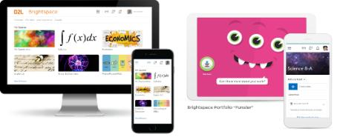
Understanding some terms...
Company:
D2L
Product:
Brightspace
Online Community:
Brightspace Community
Notes:
This is a useful slide to ensure everyone understand the terminology used when discussing Brightspace.
It would be helpful to personalize this slide to include any District specific information, especially if your District as a different branding for “Brightspace.” This will help attendees when they see resources about “Brightspace” to know that this is what your District is using as well but has branded differently.

Slide 7
Exceptional student experiences and outcomes
Equity for all students
Meaningful connections with parents
Why Educators
Brightspace
Tools teachers love
Worry-free technology
More partner, less vendor
Notes:
Here’s why customers love Brightspace

Slide 8
One-stop shop for assessment and feedback
Variety of robust tools
Assessment and Feedback in Brightspace
Multi-media assessment and feedback
Multiple submission types
Easy to use your tried and true resources or start new!
Notes:
There are many reasons Brightspace can be valuable for assessment and feedback
There are many tools and resources in Brightspace that allow it to become a one-stop shop for you and your students. By having everything in one place, this can help create consistency for your students, as they know they can find all of their assessment information and feedback in one space
As mentioned, there is a wide variety of tools available in Brightspace, which provides many options for assessment and feedback to help meet the needs of your learners, while also keeping assessments fun and engaging!
Having options for written, video, audio and pictures in your assessment and feedback provides unlimited options for supporting assessment, as well as being able to differentiate for your students
There are four submission types in Brightspace: files, text, on-paper and observed in person. Not only does this provide several options to support your students, but it also allows you to benefit from all our assessment and feedback tools, regardless of whether students are submitting their work in Brightspace. For students, it ensures they always have access to success criteria, instructions and feedback in one consistent space. No more lost Rubrics the backpack! Students will have access to all their feedback to review in time for the next assessment!
Already have a bunch of awesome resources? Great! Easily pull them into Brightspace from your computer, Google Drive or One Drive? Need to make a brand-new Assignment. No problem! Easily create assignment information from scratch. Best news? Regardless of how you pull in or create resources, once they’re in Brightspace you can easily copy these assessments to your next year’s Brightspace class- but we’ll cover that another day!
Be sure to add in information regarding your own District assessment policies and how Brightspace can help support assessment and feedback in your District!

Slide 9
Assessment and Feedback in Brightspace:
Assignments
Rubrics
Annotations
Activity Feed
Feedback
Purpose:
Purpose:
Purpose:
Purpose:
Purpose:
With 4 submission types, our Assignments tool makes it easy to make Brightspace your Assessment hub, so that students can go to one consistent place for all of their assessment needs
Our Rubric tool is an easy way to clearly define success criteria for your students and to use that same rubric to assess and provide feedback
Use our online Annotation tool to annotate student work
Interactive tool for educators to share activities and assignments on the course homepage
Social media inspired communication tool
Differentiate for your learners but having multi-media options to leave feedback for your students
Notes:
Use this slide to introduce some of the tools or features you will discuss and cover during the demo
**Be sure to confirm the terminology on this slide matches the language terms used in your District’s Brightspace environment (i.e. Assignments vs Dropbox etc)

Slide 10
Assessments and Feedback Demo
Learning Objectives:
You will be able to:
Create a new assignment
Add information and resources to your assignment
Create a rubric
Share assessment information with your students
Assess an assignment and provide feedback
Notes:
Next we’ll head into a live demo to show you how you can get started with Assessment and Feedback in Brightspace
Note: The learning objectives on this slide can be personalized to meet the needs for your District and attendees

Slide 11
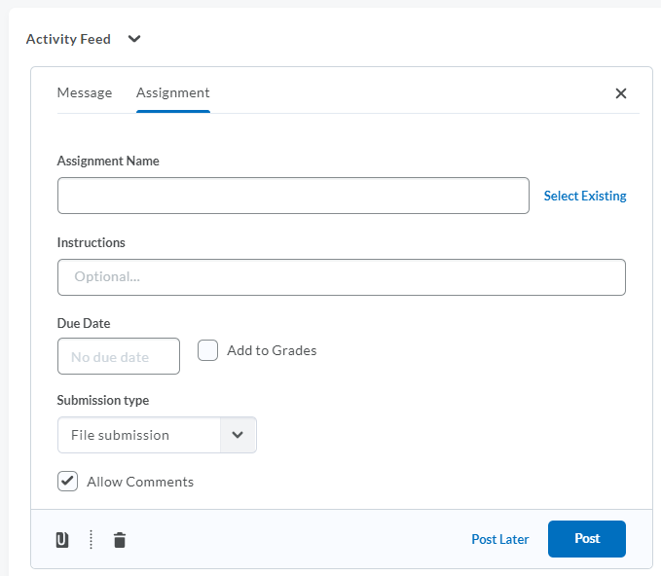
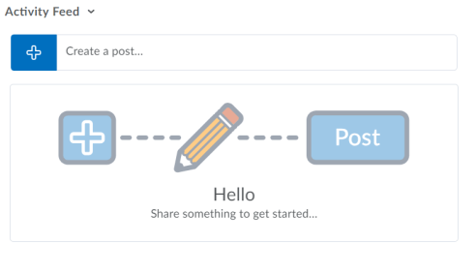
Create an Assignment in Activity Feed
1
2
To get started, click the blue add button to see your posting options
Click “Assignment”
Notes:
This slide can serve as a resource for your educators & staff after the webinar. It can also serve to help with step by steps instructions if doing a live demo is not possible.
Another option is to let your attendees know these how-to slides are in the slide deck for them to reference, and hide the remaining slides during the live webinar, and unhide them prior to send the slide deck to your attendees after the webinar.

Slide 12
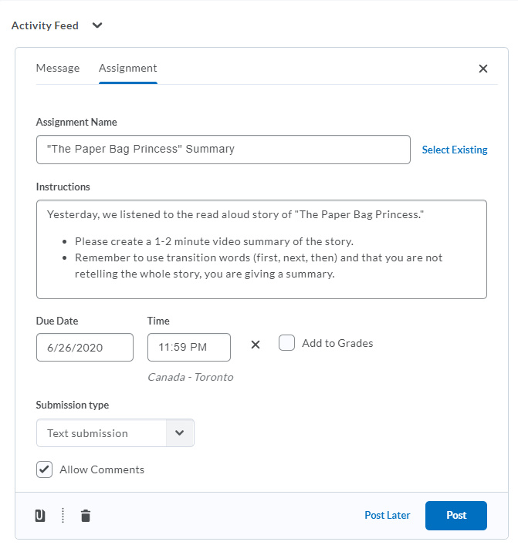
Create an Assignment in Activity Feed
1
Tip! If you have already created an assignment in the Assignments Tool, select from the “Select Existing” list and all your information will automatically populate in the Activity Feed!
2
3
4
5
Title your assignment/activity
Provide the instructions and due date for your assignment or activity
Choose how you would like students to submit their work
Attach any resources needed to help students complete the assignment
Schedule the post to populate at a future time or post immediately for your students to access
Notes:
This slide can serve as a resource for your educators & staff after the webinar. It can also serve to help with step by steps instructions if doing a live demo is not possible.
Another option is to let your attendees know these how-to slides are in the slide deck for them to reference, and hide the remaining slides during the live webinar, and unhide them prior to send the slide deck to your attendees after the webinar.

Slide 13
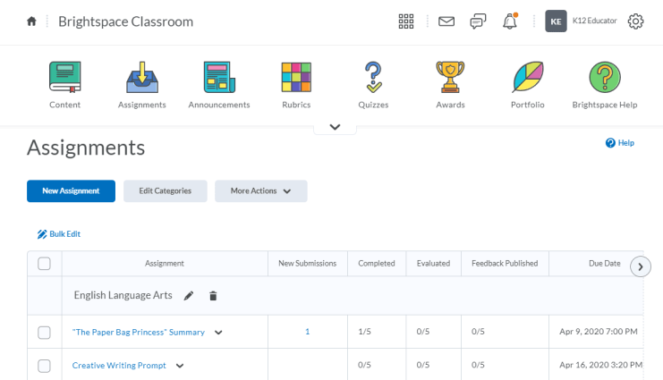
Create an Assignment in the Assignments Tool
1
2
Click the “Assignments” tool from your Nav Bar or from your list of tools in “Course Admin”
Click “New Assignments”
Notes:
This slide can serve as a resource for your educators & staff after the webinar. It can also serve to help with step by steps instructions if doing a live demo is not possible.
Another option is to let your attendees know these how-to slides are in the slide deck for them to reference, and hide the remaining slides during the live webinar, and unhide them prior to send the slide deck to your attendees after the webinar.

Slide 14
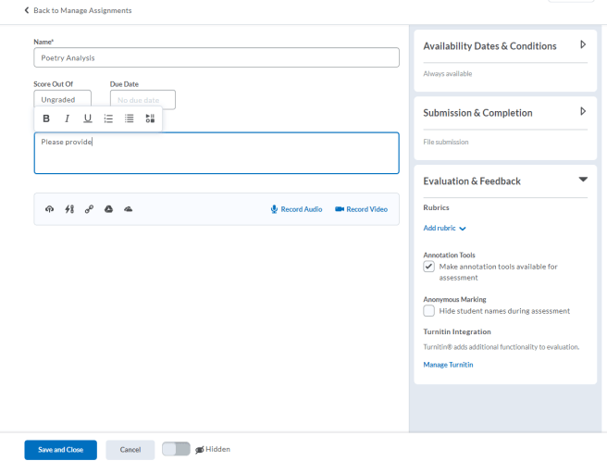
Create an Assignment in the Assignments Tool
Type your assignment name, instructions, grading and due date information
Attach any resources your students need, or add a quick audio or video recording to assist students
Use the addition features on the right-hand side to add additional options for your assignment, like adding a rubric, or selecting the submission type. Use the arrow to expand each category to see your options
Choose if your assignment will be visible right away for students, or hidden for now, and then click “Save and Close”
1
3
2
4
Notes:
This slide can serve as a resource for your educators & staff after the webinar. It can also serve to help with step by steps instructions if doing a live demo is not possible.
Another option is to let your attendees know these how-to slides are in the slide deck for them to reference, and hide the remaining slides during the live webinar, and unhide them prior to send the slide deck to your attendees after the webinar.

Slide 15
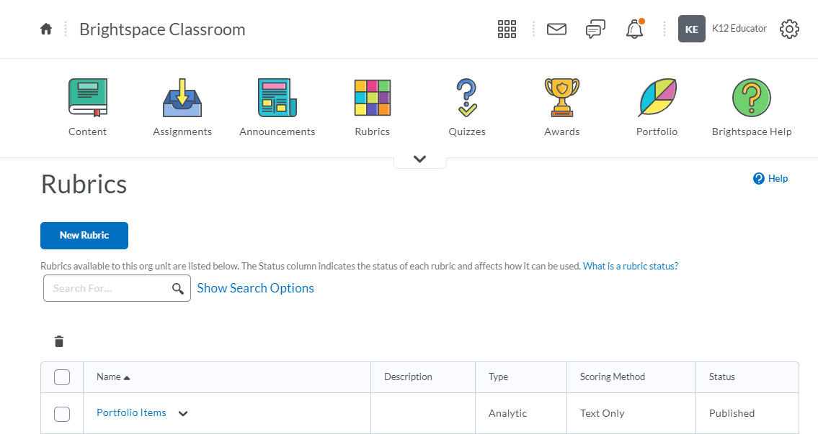
Create a Rubric
1
2
Click the “Rubrics” tool from your Nav Bar or from your list of tools in “Course Admin”
Click “New Rubric”
Notes:
This slide can serve as a resource for your educators & staff after the webinar. It can also serve to help with step by steps instructions if doing a live demo is not possible.
Another option is to let your attendees know these how-to slides are in the slide deck for them to reference, and hide the remaining slides during the live webinar, and unhide them prior to send the slide deck to your attendees after the webinar.

Slide 16
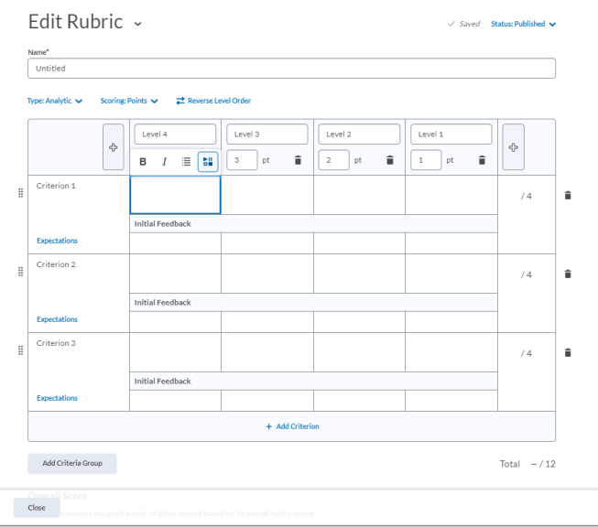
Create a Rubric
Change to a text-only rubric here
1
Title your rubric
Provide success criteria and add curriculum expectations
Provide descriptors for each level of your rubric- including text or multimedia
Provide initial feedback to pop up when you assess using the rubric (you can still personalize this for each student later!)
Click “Close” when you are finished making your rubric!
Rubrics auto-save and are published by default. You can change to a draft status here
2
3
4
5
Notes:
This slide can serve as a resource for your educators & staff after the webinar. It can also serve to help with step by steps instructions if doing a live demo is not possible.
Another option is to let your attendees know these how-to slides are in the slide deck for them to reference, and hide the remaining slides during the live webinar, and unhide them prior to send the slide deck to your attendees after the webinar.

Slide 17
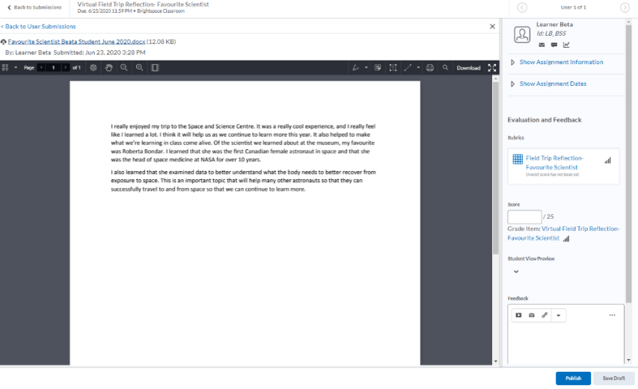
Assess and Provide Feedback on an Assignment
Annotation Tool
Rubric
Grading information
Written and multimedia feedback options
Publish feedback now or save as a draft to publish later
Notes:
This slide can serve as a resource for your educators & staff after the webinar. It can also serve to help with step by steps instructions if doing a live demo is not possible.
Another option is to let your attendees know these how-to slides are in the slide deck for them to reference, and hide the remaining slides during the live webinar, and unhide them prior to send the slide deck to your attendees after the webinar.

Slide 18
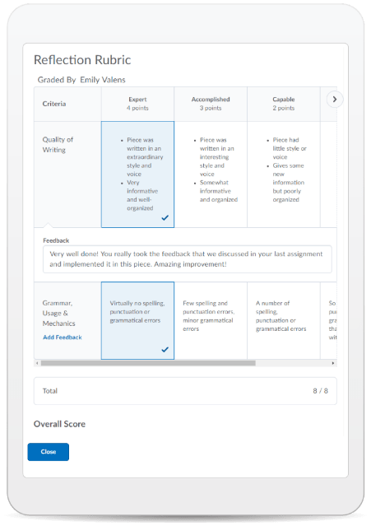
Learning Objectives:
You will be able to:
Create a new assignment
Add information and resources to your assignment
Create a rubric
Share assessment information with your students
Assess an assignment and provide feedback
© 2020 D2L Corporation
Notes:
This slide can serve as a resource for your educators & staff after the webinar. It can also serve to help with step by steps instructions if doing a live demo is not possible.
Another option is to let your attendees know these how-to slides are in the slide deck for them to reference, and hide the remaining slides during the live webinar, and unhide them prior to send the slide deck to your attendees after the webinar.

Slide 19
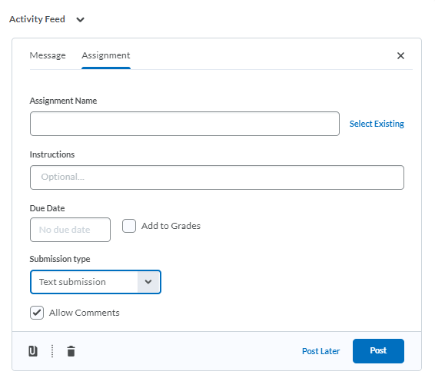
Give This a Try!
Use Activity Feed to create a quick text-based submission to check in with your students or for students to submit an exit ticket
Create a Rubric to use on your next activity or assignment
Notes:
Looking on how to get started? Give one of these take away activities a try!

Slide 20
Resources
Annotating an Assignment
Brightspace Quick Start Guide K-12
Creating an Assignment in Activity Feed
Creating a Rubric
D2L Parent and Guardian Support Site
Overview of Activity Feed
Notes:
This page has resources specifically on assessment and feedback in Brightspace. This is also where District specific resources can be added.

Slide 21
Tutorial Videos
Communication and Collaboration | Organizing Course Materials | Documenting Student Learning | Feedback & Assessment
Announcements Activity Feed -Add Attachments and Links to Posts -Create an Assignment Post in Activity Feed -Customize Notifications for Activity Feed -For posting a message -Optimize Activity Feed Discussions | Content/Lessons Tool -Getting Started with Lessons for Instructors -Lessons: Add a New Unit and Lesson -Lessons: Add New Materials -Lessons: Reorder Units, Lessons, Folders, and Materials -Lessons: Attach a Release Condition Groups -Creating Groups -Creating Individual Student Groups -Creating Unique Learner Pathways | Brightspace Portfolio -Review and Approve Portfolio Items -Oversee and View Individual Portfolios -Brightspace Portfolio: Bring Your Own Device (for learners) -Portfolio AT HOME Assignments Discussions Quizzes -Quiz Question Converter | Rubrics -Create an Analytic Rubric -Create a Holistic Rubric Grades -Entering Grades -Associate an Activity with a Grade Item -Create a Grade Scheme Standards/Expectations -Standards: Import Standards from Course Admin Assessing or Evaluating Against Expectations Quick Eval
Notes:
There are also many quick tutorial videos available! These resources are organized pedagogically. Every underlined item is linked to a tutorial video

Slide 22
Thank you!
@Twitterhandle
#districthashtag
#D2LK12
Notes:
Thank you so much for joining us today!
If you have any questions or need any help, please consult or contact:
We’d love to see all the awesome ways you’re using Brightspace! Use our District hashtag and/or #D2LK12 so we can all learn from each other and share great ideas of how to use Brightspace to support teaching, learning and, most importantly, our students!

